Slide 1
Math 170 Functions, Data, and Models
45 Combination examples
Section 10.3

Slide 2
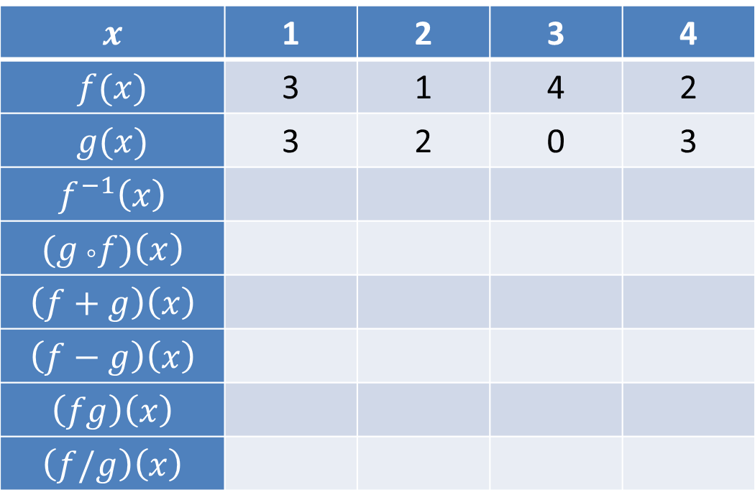
Table Combinations
Fill in the table.
 | 1 | 2 | 3 | 4
 | 3 | 1 | 4 | 2
 | 3 | 2 | 0 | 3

Slide 3
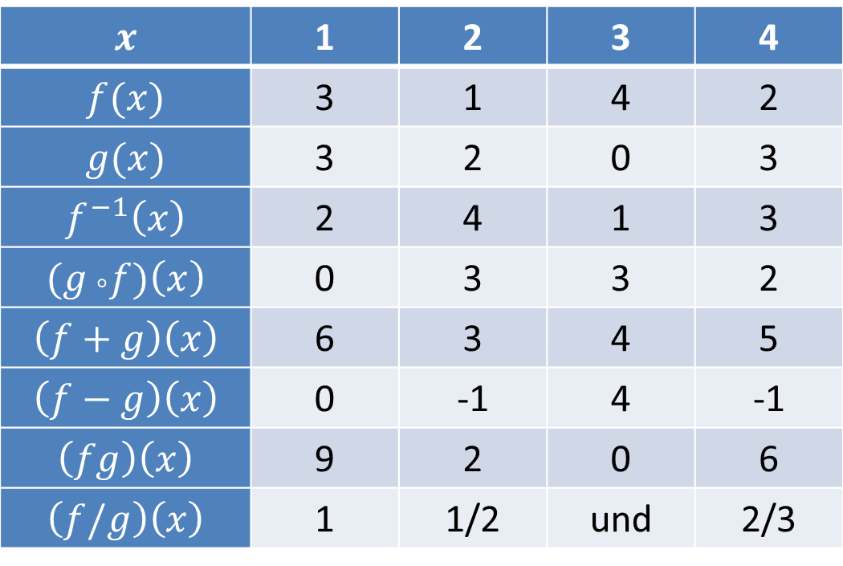
Table Combinations Answers
Fill in the table.
 | 1 | 2 | 3 | 4
 | 3 | 1 | 4 | 2
 | 3 | 2 | 0 | 3
 | 2 | 4 | 1 | 3
 | 0 | 3 | 3 | 2
 | 6 | 3 | 4 | 5
 | 0 | -1 | 4 | -1
 | 9 | 2 | 0 | 6
 | 1 | 1/2 | und | 2/3

Slide 4
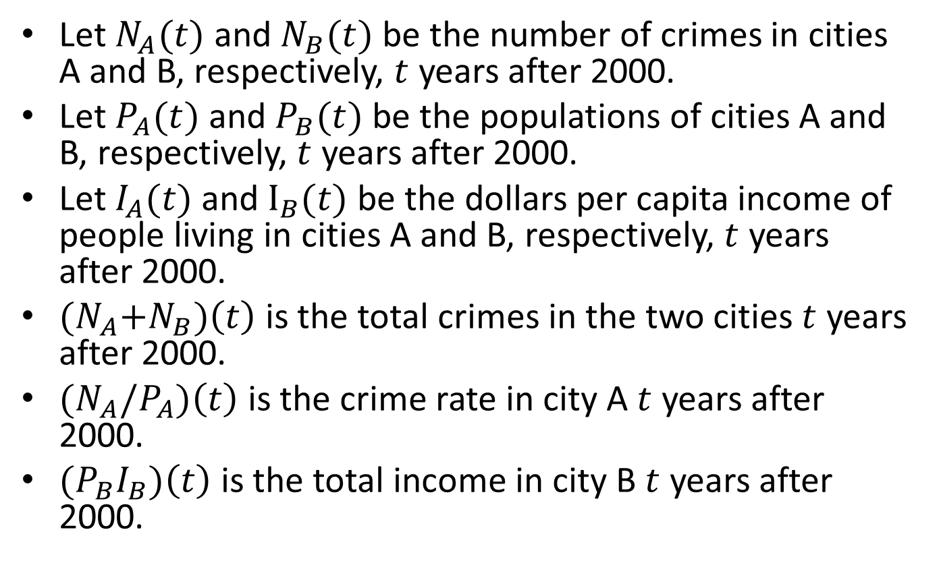
Word Combinations
Let $N_{A}(t)$ and $N_{B}(t)$ be the number of crimes in cities A and B, respectively, $t$ years after 2000.
Let $P_{A}(t)$ and $P_{B}(t)$ be the populations of cities A and B, respectively, $t$ years after 2000.
Let $I_{A}(t)$ and $I_{B}(t)$ be the dollars per capita income of people living in cities A and B, respectively, $t$ years after 2000.
${(N}_{A}+N_{B})\left(t\right)$ is the total crimes in the two cities $t$ years after 2000.
${(N}_{A}/P_{A})\left(t\right)$ is the crime rate in city A $t$ years after 2000.
${(P}_{B}I_{B})\left(t\right)$ is the total income in city B $t$ years after 2000.

Slide 5
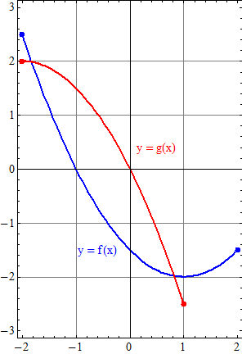
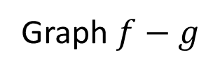
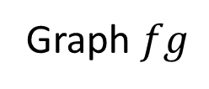
Graph $f−g$
Graph $fg$

Slide 6
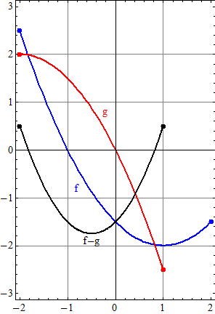
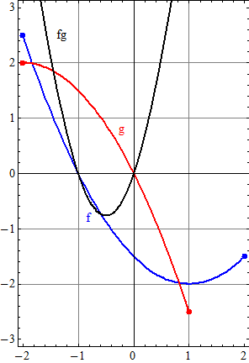
Graph $f−g$
Graph $fg$

Slide 7
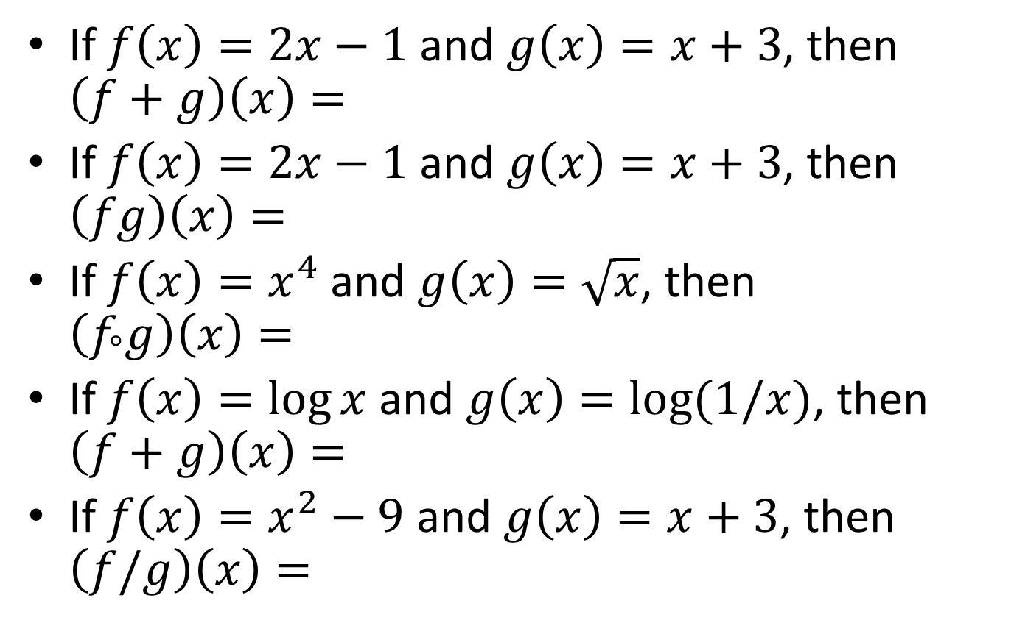
Formula Combinations
If $f\left(x\right)=2x−1$ and $g\left(x\right)=x+3$, then $\left(f+g\right)\left(x\right)=$
If $f\left(x\right)=2x−1$ and $g\left(x\right)=x+3$, then $\left(fg\right)\left(x\right)=$
If $f\left(x\right)=x^{4}$ and $g\left(x\right)=\sqrt{x}$, then $\left(f_{°}g\right)\left(x\right)=$
If $f\left(x\right)=\log{x}$ and $g\left(x\right)=\log{(1/x)}$, then $\left(f+g\right)\left(x\right)=$
If $f\left(x\right)=x^{2}−9$ and $g\left(x\right)=x+3$, then $\left(f/g\right)\left(x\right)=$

Slide 8
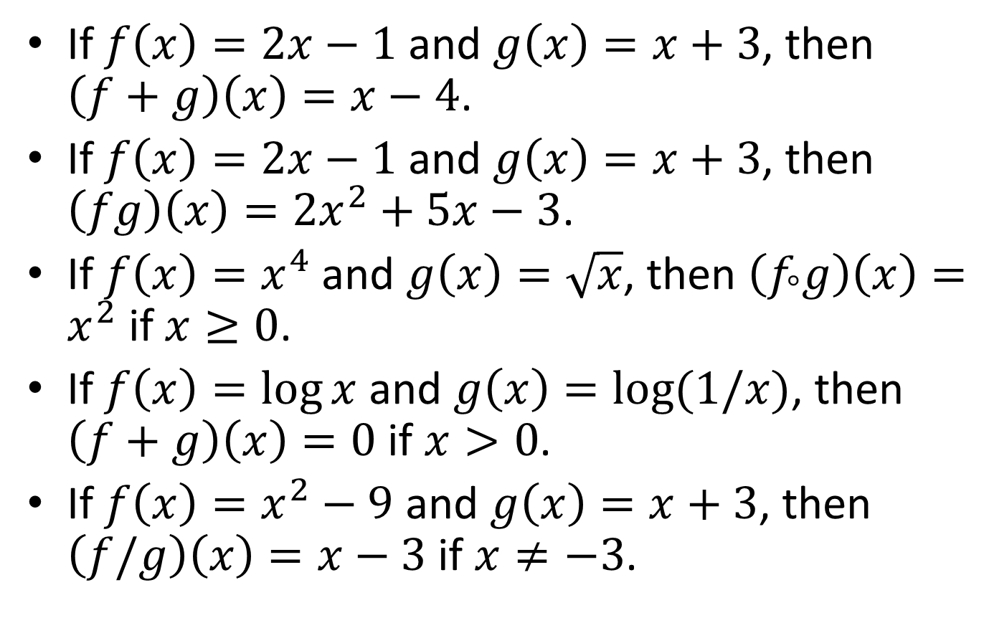
Formula Combinations Answers
If $f\left(x\right)=2x−1$ and $g\left(x\right)=x+3$, then $\left(f+g\right)\left(x\right)=x−4$.
If $f\left(x\right)=2x−1$ and $g\left(x\right)=x+3$, then $\left(fg\right)\left(x\right)={2x}^{2}+5x−3$.
If $f\left(x\right)=x^{4}$ and $g\left(x\right)=\sqrt{x}$, then $\left(f_{°}g\right)\left(x\right)=x^{2} \text{if} x≥0\text{.}$
If $f\left(x\right)=\log{x}$ and $g\left(x\right)=\log{(1/x)}$, then $\left(f+g\right)\left(x\right)=0$ if $x>0$.
If $f\left(x\right)=x^{2}−9$ and $g\left(x\right)=x+3$, then $\left(f/g\right)\left(x\right)=x−3$ if $x≠−3$.

